Slide 1
Ba 260: Lecture 7
Lecture 7: Technology
Notes:
https://www.youtube.com/watch?v=opNiKBP7hQo

Slide 2
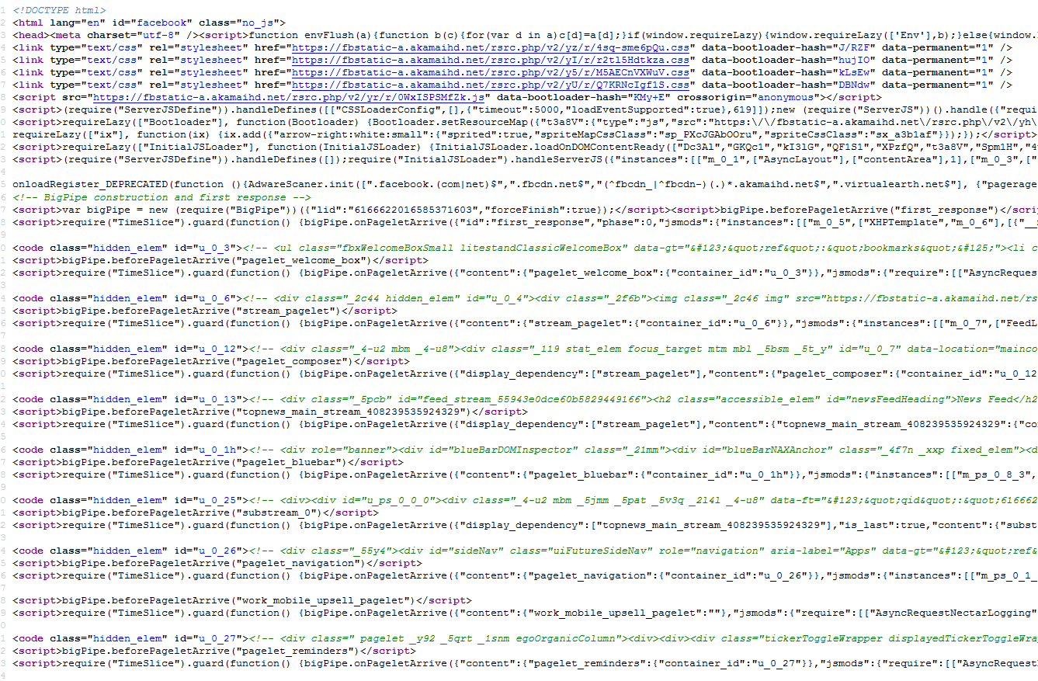
Ba 260: Lecture 7 Technology
Fundamentals of a Web Page
HTML
CSS
Facebook

Slide 3

Ba 260: Lecture 7 Technology
Design Environment
Cloud
Server
Client

Slide 4

Ba 260: Lecture 7 Technology
Web Development
Client
HTML
CSS
Javascript
Jquery
Server
PHP
Java
Python
C# .NET
If this looks old fashioned it is because it is an old language

Slide 5
Ba 260: Lecture 7 Technology
How you can get started
ONID Space
Hosting
Windows Apache MySQL PHP Server (WAMP, LAMP or AAMPs)
Learning Tools
W3 Schools (Some programmers criticize this site, my personal thoughts are that it is better then many other sites out there you will find. Your best bet is solid courses or books)

Slide 6
Ba 260: Lecture 7 Technology
Development Tools
Building a Web page
Notepad ++
Dreamweaver
Sublime Text Editor

Slide 7

Ba 260: Lecture 7 Technology
Mobile
Native vs Non-native
Apple
Swift
Objective C
Android
Java
XML
Non Native
HTML, CSS Web Technologies

Slide 8
Ba 260: Lecture 7 Technology
Mobile Development Tools
Making an App
Apple
X Code
Android
Was Eclipse IDE but now it is migrating to Android Studio
Non Native
Same as web
Build options Phone Gap (Adobe)

Slide 9

Ba 260: Lecture 7 Technology
Web builders
Wordpress
Weebly
Wix
Web Templates
Bootstrap
HTML 5
Foundation
Commerce
Shopify
Squarespace

Slide 10

Ba 260: Lecture 7 Technology
Payment Options
Stripe
Paypal
Square
Technology has helped smaller businesses conduct business at events like the Corvallis Fall Festival

Slide 11
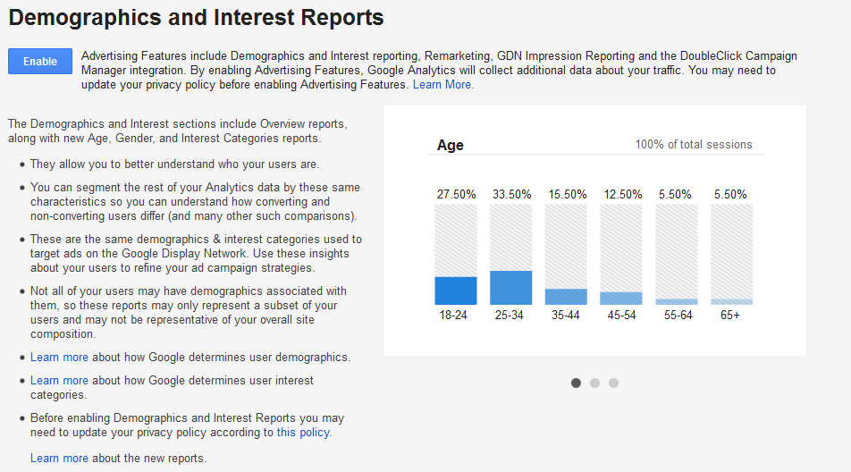
Ba 260: Lecture 7 Technology
Analytics and SEO
Google Analytics
If you use WordPress they have plugins that can help you set this up
Notes:
How the tracking works:
https://developers.google.com/analytics/resources/concepts/gaConceptsTrackingOverview

Slide 12

Ba 260: Lecture 7 Technology
Version Control
Git
GitHub
Bit Bucket
SVN
Trending Repositories (Here)

